Slide 1



Networked-Wireless Offline Digital Education System (N.O.D.E.S)
N.O.D.E.S. is a revolutionary approach to digital education in rural and remote areas. By establishing physical data servers in underserved regions, the project aims to provide consistent access to high-quality educational resources.
by NISHANT SANKAR SWAIN

Slide 2

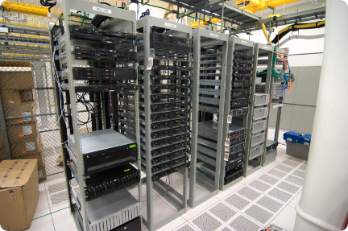
Establishing Physical Data Servers
Physical data servers are installed in each rural region to ensure consistent and reliable access to educational resources. The servers provide offline content and support the N.O.D.E.S. platform.
Accessibility
Scalability
Security
Physical servers eliminate reliance on unstable internet connections. This ensures continuous access to educational materials.
The server infrastructure can be easily scaled to meet the growing needs of the community.
Local servers provide greater control and security over sensitive student data.

Slide 3
Hosting an Offline Website with Wi-Fi Connectivity
Each server hosts an offline website accessible through Wi-Fi. This allows students to access educational materials without relying on an active internet connection.
Offline Access
Wi-Fi Connectivity
Content Access
Students can learn even in areas with limited internet connectivity. This promotes consistent learning opportunities.
The server provides a secure Wi-Fi network that allows students to access the offline website.
The offline website hosts a library of educational resources, including textbooks, videos, and interactive exercises.

Slide 4


Providing Access to Educational Content
The N.O.D.E.S. server provides access to a wide range of educational resources, including textbooks, videos, and interactive exercises. The platform caters to diverse learning styles and educational needs.
1
Textbooks
2
Videos
Digital copies of textbooks provide students with access to comprehensive learning materials.
Educational videos enhance learning by providing visual explanations and interactive content.
3
Interactive Exercises
4
Multimedia Resources
Interactive exercises provide students with opportunities to practice and test their understanding.
The platform incorporates multimedia resources such as animations, simulations, and audio recordings.

Slide 5


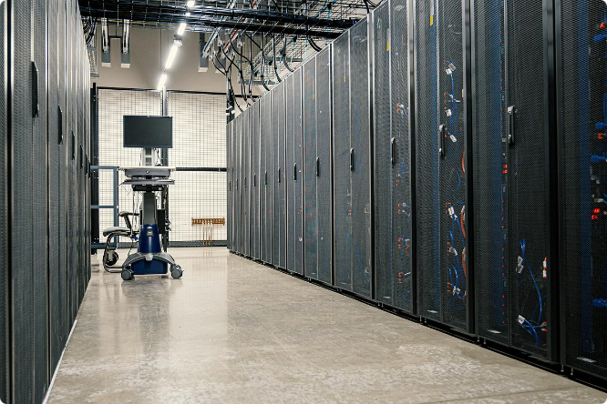



Database Connectivity and Administration
The project leverages database connectivity to manage and organize educational resources efficiently. The database system ensures data integrity and facilitates user access.
Database Design
The database is designed to store and manage user information, course materials, and performance metrics.
Data Security
Data security measures are implemented to safeguard student information and prevent unauthorized access.
Data Management
The database system enables efficient management of educational content and facilitates regular updates.
Data Analysis
Data analysis tools provide insights into student engagement and learning outcomes.

Slide 6


Village Database Management
The N.O.D.E.S. system includes a village database, which records demographic information and learning progress of students in each community.
Student Name
Age
Grade
School
Progress
Aisha
12
7
Mwadui Primary School
Excellent
James
13
8
Mwadui Primary School
Good
Mary
11
6
Mwadui Primary School
Needs Improvement

Slide 7


Challenges in Implementing the System
Implementing the N.O.D.E.S. system presents a number of challenges, including logistics, training, and technology maintenance.
Logistics
1
Transporting and installing servers in remote areas can be challenging due to poor infrastructure.
2
Training
Training teachers and students on how to use the N.O.D.E.S. platform is crucial for successful implementation.
Technology Maintenance
3
Maintaining and troubleshooting server equipment in remote areas requires specialized technical expertise.

Slide 8





Benefits of the N.O.D.E.S. Approach
N.O.D.E.S. provides a number of benefits for students, teachers, and communities, including improved access to education, enhanced learning outcomes, and increased community development.
Improved Access
N.O.D.E.S. provides students in rural areas with consistent access to high-quality educational resources.
Enhanced Learning Outcomes
The platform fosters active learning through multimedia resources and interactive exercises, leading to better academic outcomes.
Community Development
N.O.D.E.S. empowers communities by providing access to knowledge and promoting economic opportunities.

